Slide 1
Linked List

Slide 2
Linked List
A linked list is a dynamic data structure where each element (called a node) is made up of two items - the data and a reference (or pointer) which points to the next node. A linked list is a collection of nodes where each node is connected to the next node through a pointer.

Slide 3
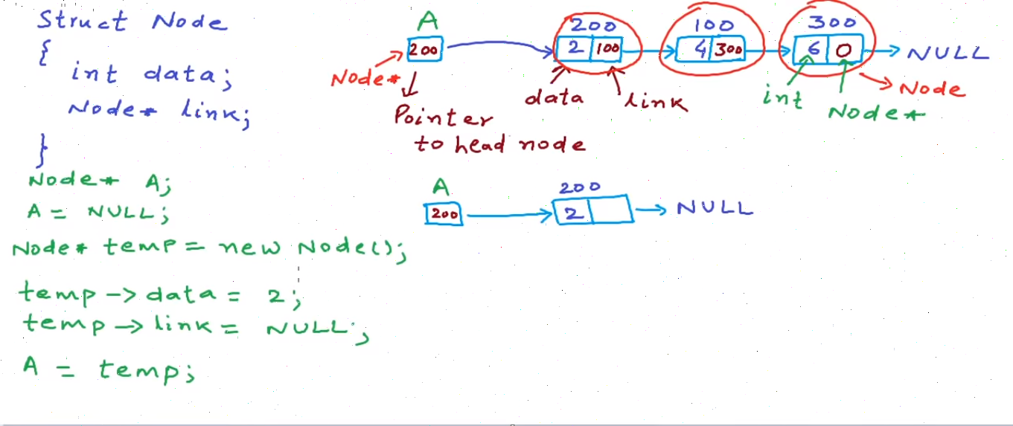
Linked List

Slide 4
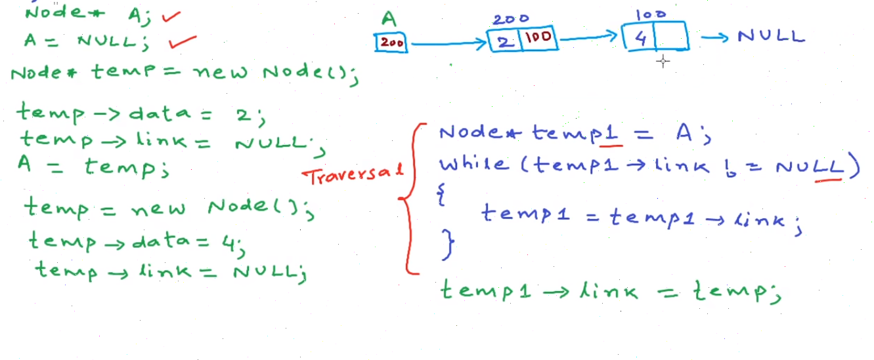
Linked List : Insertion at end

Slide 5

Linked List : Insertion at begining

Slide 6
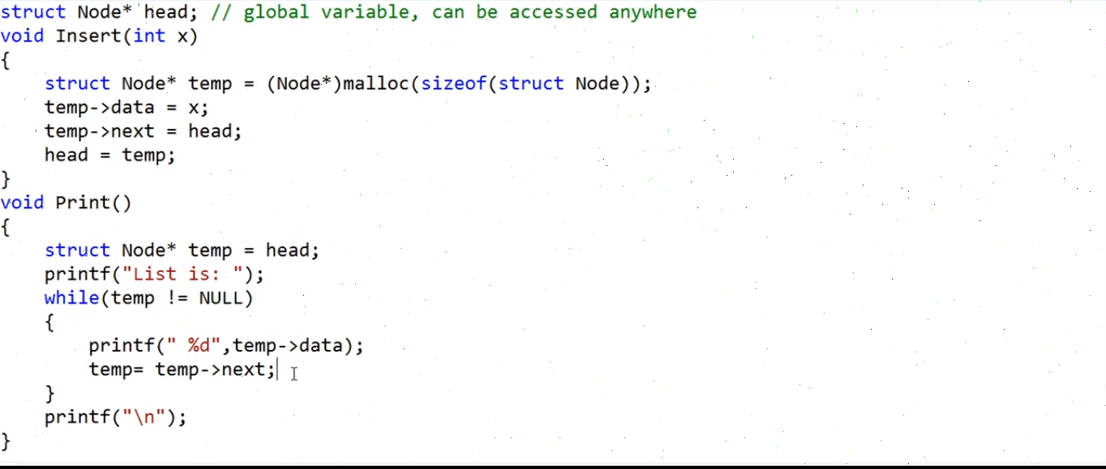
Linked List : Insertion at begining

Slide 7
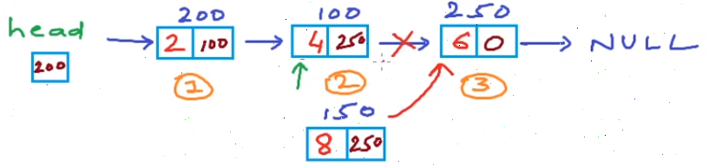
Linked List : Insertion at nth position

Slide 8
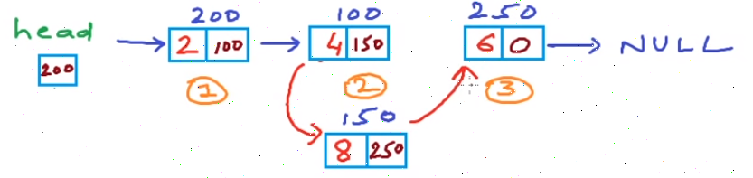
Linked List : Insertion at nth position

Slide 9
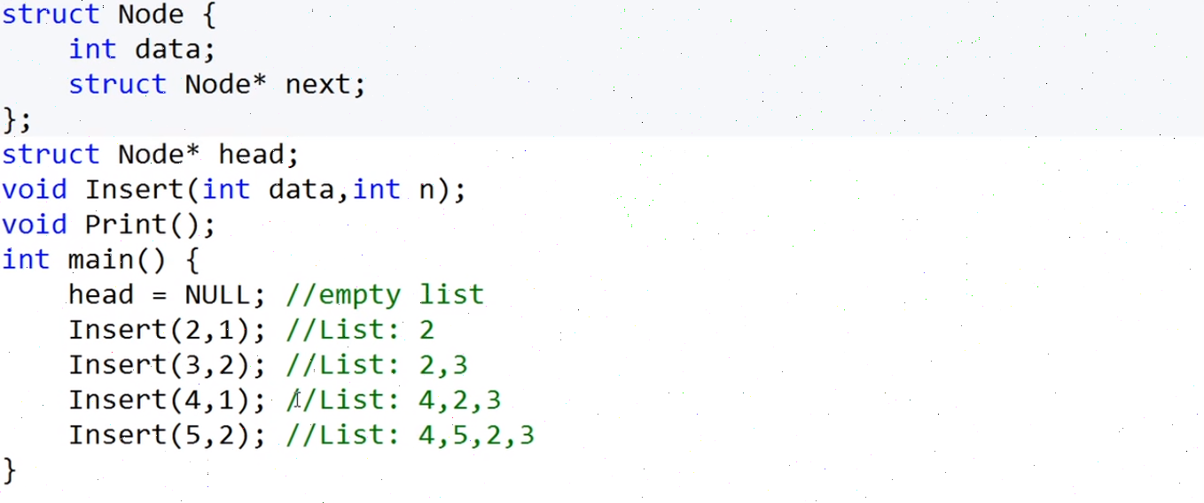
Linked List : Insertion at nth position

Slide 10
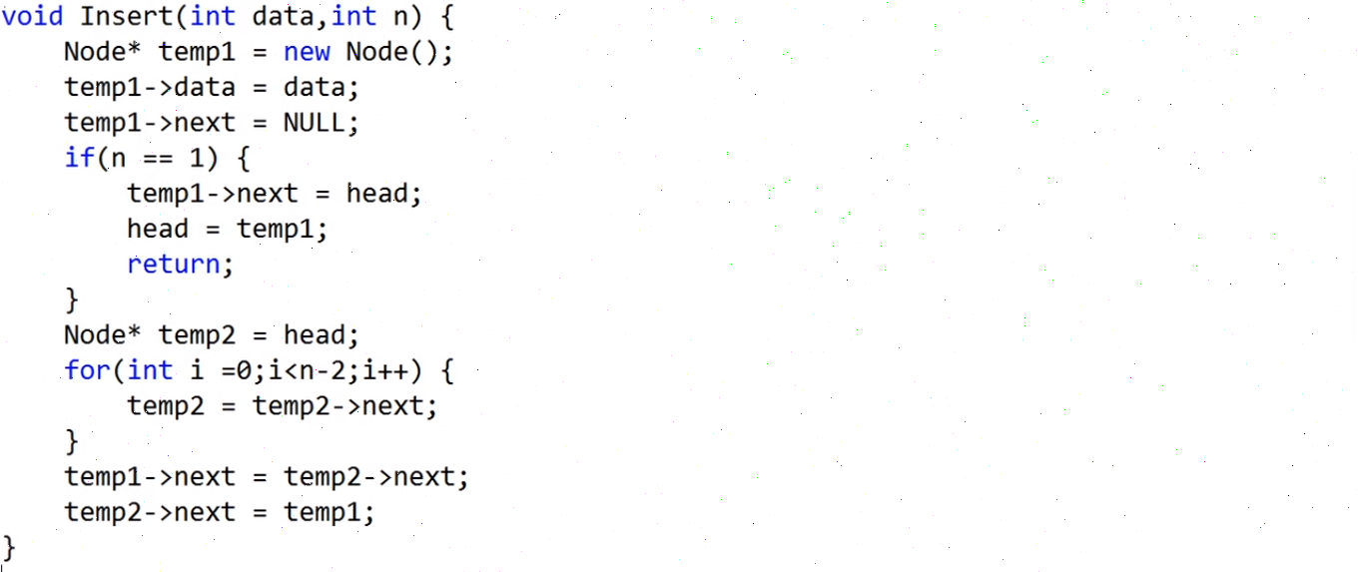
Linked List : Insertion at nth position

Slide 11
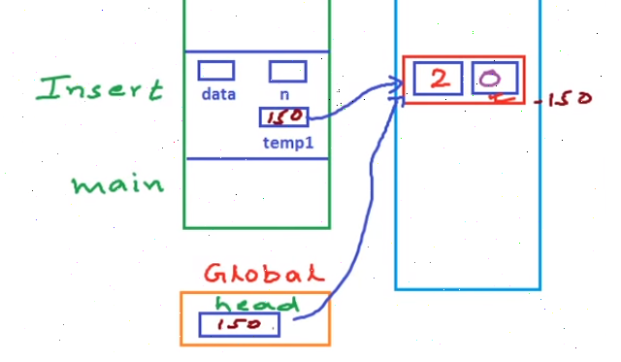
Linked List : Insertion at nth position

Slide 12
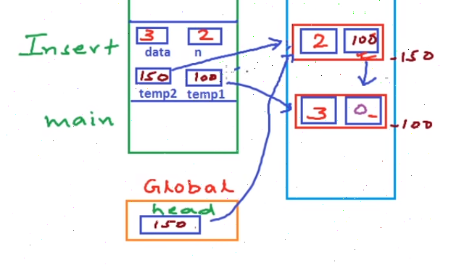
Linked List : Insertion at nth position

Slide 13
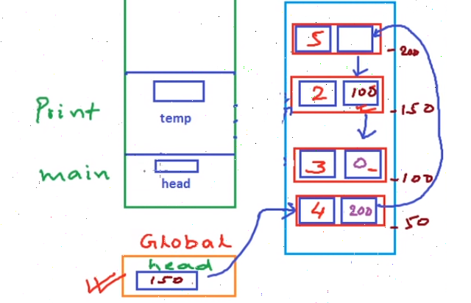
Linked List : Insertion at nth position

Slide 14
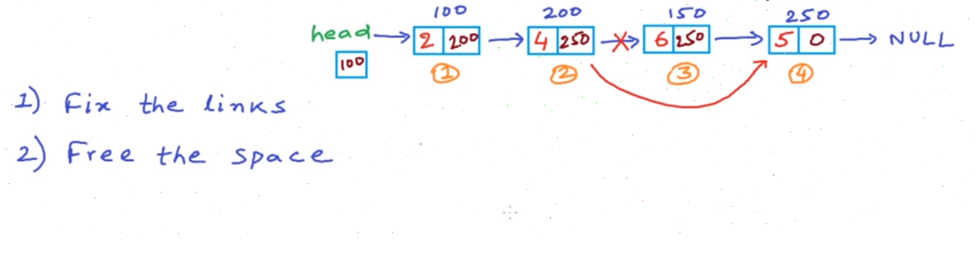
Linked List : Deletion at nth position

Slide 15
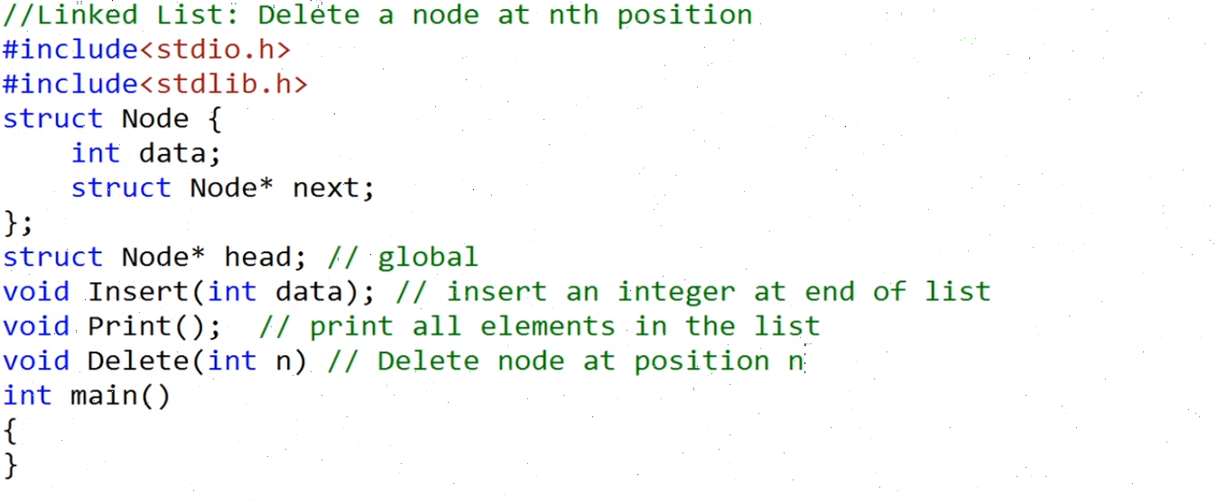
Linked List : Deletion at nth position

Slide 16

Linked List : Deletion at nth position

Slide 17
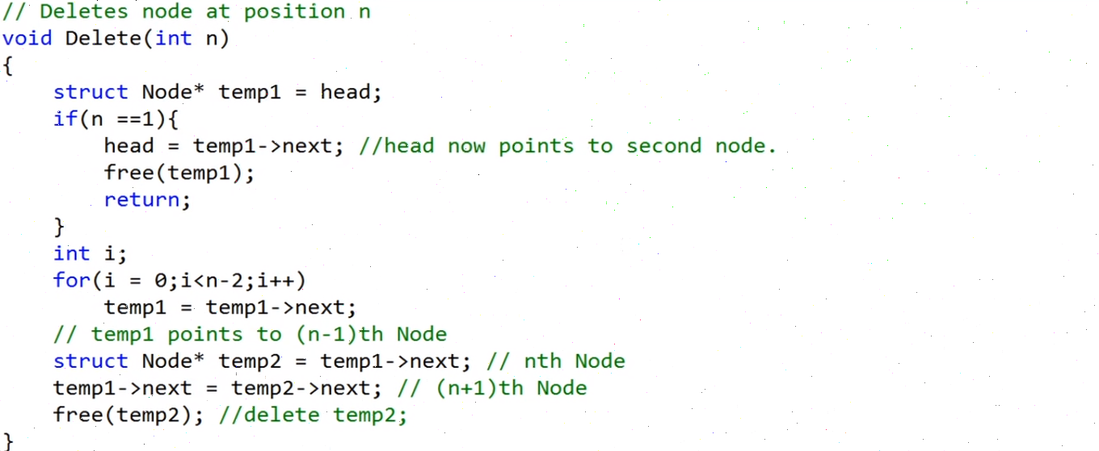
Linked List : Deletion at nth position

Slide 18
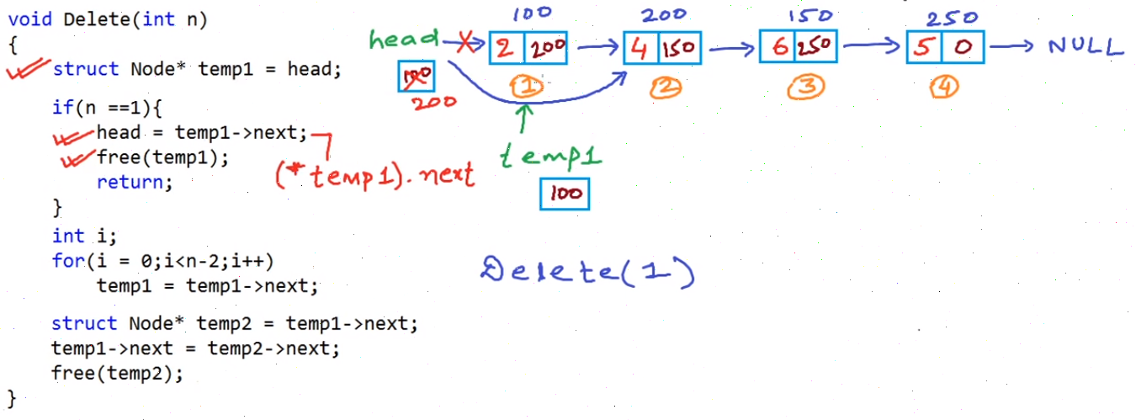
Linked List : Deletion at nth position

Slide 19
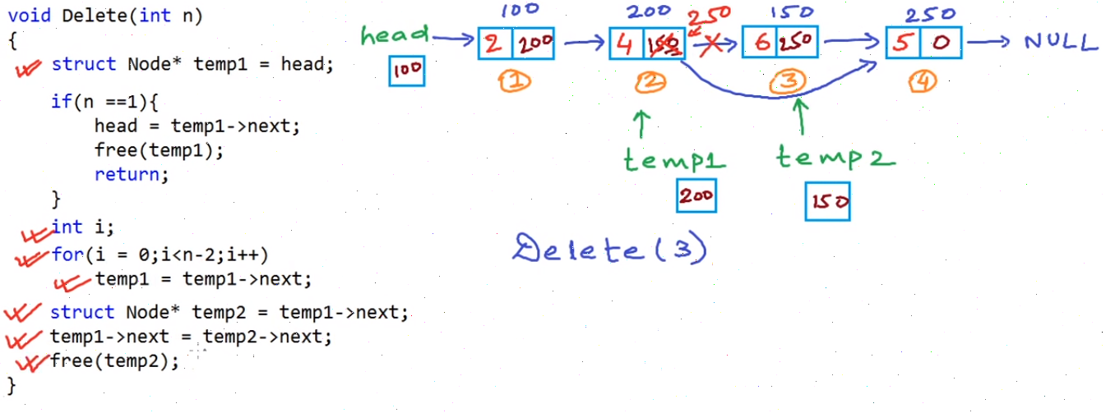
Linked List : Deletion at nth position

